Slide 1
MICROSOFT MOVIE DATA ANALYSIS
RICHARD ETYANG

Slide 2
PROBLEM STATEMENT
Microsoft sees all the big companies creating original video content and they want to get in on the fun. They have decided to create a new movie studio, but they don’t know anything about creating movies. You are charged with exploring what types of films are currently doing the best at the box office. You must then translate those findings into actionable insights that the head of Microsoft's new movie studio can use to help decide what type of films to create.

Slide 3
BUSINESS UNDERSTANDING
Creation of video content by big companies has been on the rise for the past decades due to the changing dynamics in the market. Microsoft is one big company established in 1975 to develop software and hardware which are in use to date. However, vast competition has been mounted to them with other companies propelling them to start creating video content to improve their status quo. They aim to begin the process by creating a new movie studio. There is a wide array of films which are doing well and encapsulated in different sets of data which needs proper analysis in order to take appropriate steps by the company.

Slide 4
MAIN OBJECTIVES
My main objective is to find out the performance of the different films and assist develop actionable insights for appropriate decision making by the Microsoft company.

Slide 5
SPECIFIC OBJECTIVES
To find out which movies generate high domestic and foreign gross Income.
To investigate which genre is the most preferred.
To find out the average rating for each genre in relation to the number of votes received.

Slide 6

ANALYSIS TOOLS

Slide 7

ANALYSIS PROCESS

Slide 8
DATA VISUALIZATION
The graphs below are derived from the three data sets each of them comparing different parameters.

Slide 9
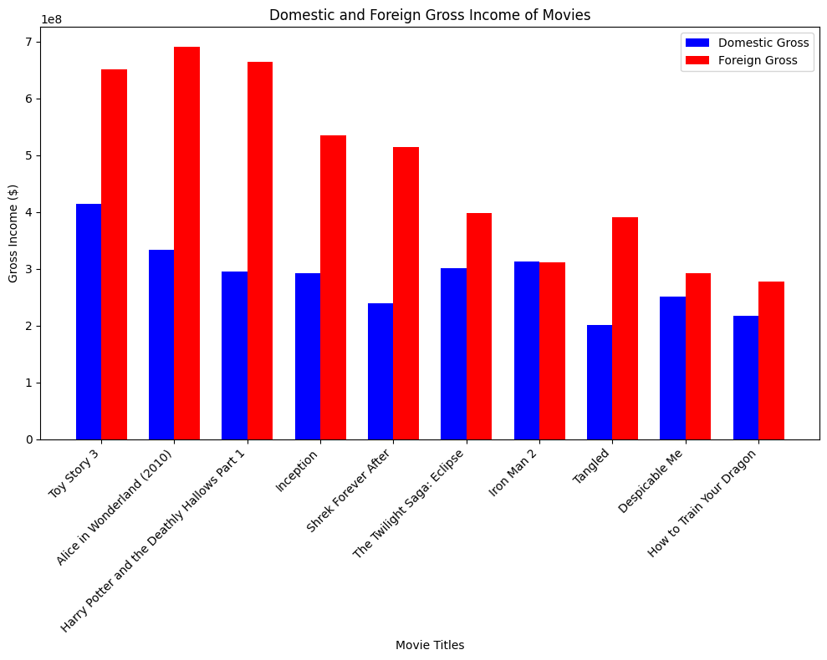
DOMESTIC AND FOREIGN INCOME OF MOVIES

Slide 10
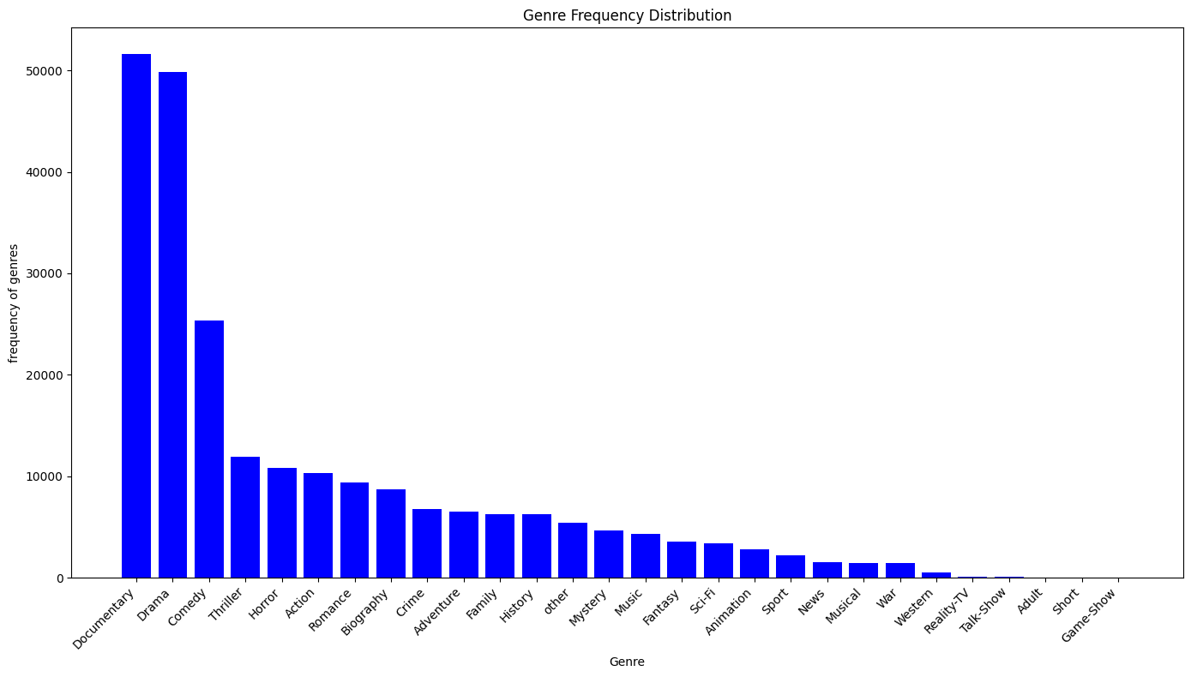
GENRE FREQUENCY DISTRIBUTION

Slide 11
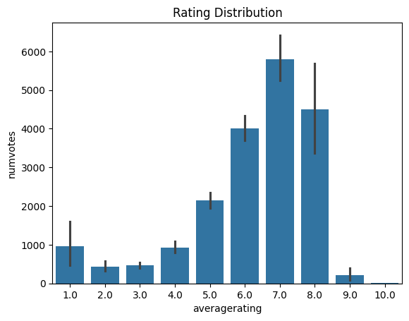
RATE DISTRIBUTION BETWEEN AVERAGE RATING AND NUMBER OF VOTES

Slide 12
RECOMMENDATIONS
Microsoft needs to consider the movie types which generate high cumulative foreign and domestic gross income.
Toy story, Alice in the wonderland(2010), harry porter and the deathly hallows ,inception and Shreck forever after appear to generate a high cumulative domestic and foreign income which makes them to be the films to be highly considered by the company while creating video content
Documentary and drama serves to be the best genre which is preferred. The company should implement this genre in their production.
The average rating of different genres corresponds to the number of votes. The company should thus consider a movie which has both a high rating and also received good number of votes

Slide 13


